Slide 1
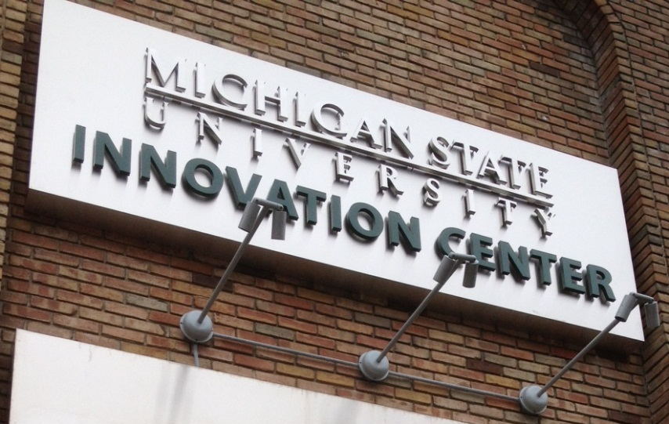
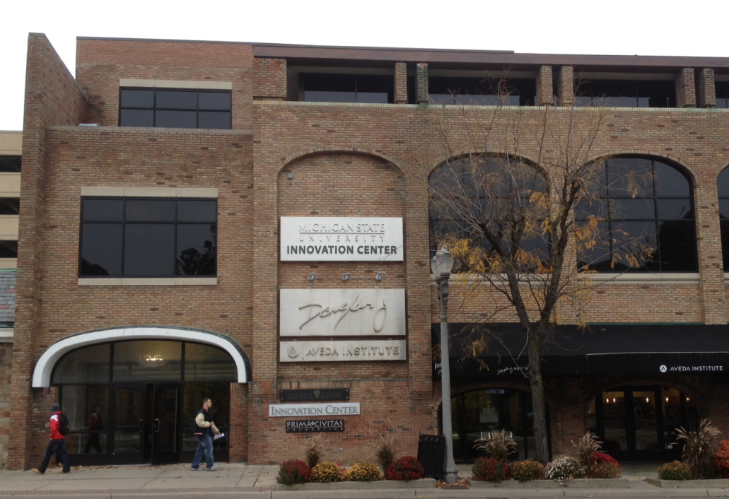
MSU’s place for connecting to the private sector

Slide 2
MSU Innovation Center
Connecting MSU research to companies that are interested in what we do.
Company perspectives enrich faculty research
$11 Million in grants last year
Taking faculty ideas to the marketplace – seeing research put to practice.
$4.4 million in royalty revenue last year
>$500,000 distributed to faculty
Creating companies from MSU-owned ideas.
Professional help to create the best chance for success.
Engaging students in alternative careers.
Creating companies from student’s ideas.
Experiential part of undergraduate entrepreneurship education
Preparing students for the real world.

Slide 3
Working with MSU Commercialization Offices
B-C:
Corporate
SPONSORED RESEARCH
MSUT:
Corporate
LICENSES
Advancement:
Corporate & Foundation Relations
GIFTS
Spartan Innovations:
Investors, Companies
START-UPs
WHO:
Works with whom?
DOING WHAT?
Don’t do grants from:
Federal
State
Non-profits

Slide 4
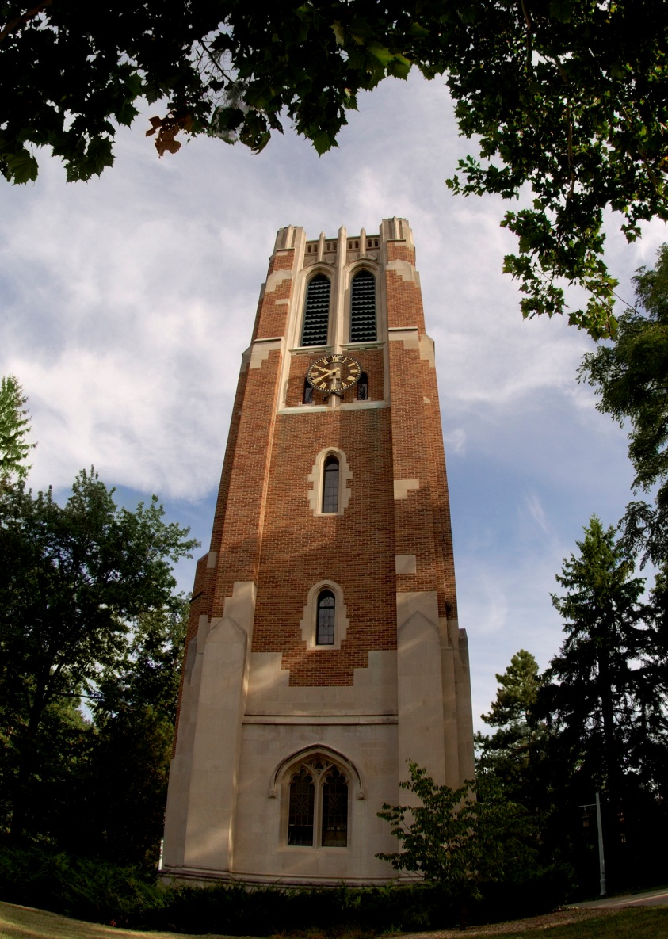
Business-CONNECT: The Front Door to MSU
Identify MSU Resources: we help companies find researchers & facilities; we navigate the university for them
Build Partnerships: we do proactive business development to build on strategic opportunities – bring us your ideas
One-Stop Shop: We act as an advocate for the deal, translating among stakeholders to find the win-win; we negotiate and sign the agreements

Slide 5
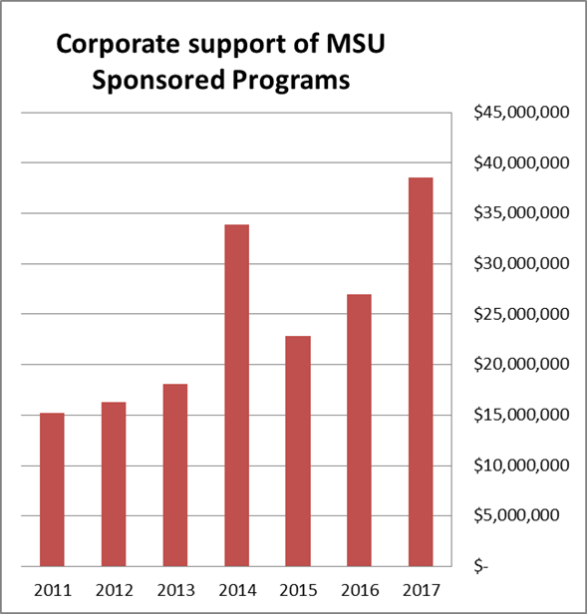
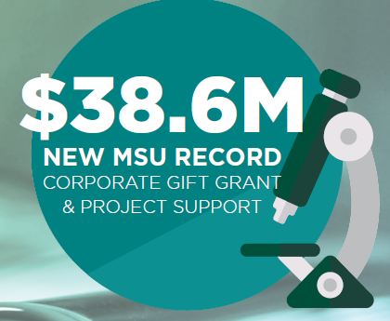
MSU has a large variety of industry partners – growing every year.

Slide 6
How can you work with Business-CONNECT?
How can you work with Business-CONNECT?
Start early. As soon as you are aware of a possibility of partnering with industry, come to Business-CONNECT. Companies may need to move fast; the sooner you get us involved, the better we can match that pace.
Build relationships. MSU wants to build solid bridges to commercial partners. Engage with colleagues in industry when you meet them; treat a sponsored research project as a real partnership; follow through on obligations.
Protect MSU assets. Be aware of how your work can generate new intellectual property. Work with Business-CONNECT and MSU-Technologies by discussing any IP potential of your work.
Again, start early.

Slide 7
Business-CONNECT also does “Business Development”
Business-CONNECT also does “Business Development”
Identify MSU areas of strength: Review of areas of federal funding, publication and citation rates, or company recruiting on campus. Where do we have critical mass?
Current emphasis: Automotive/Mobility; Plant Biotechnology; Animal Sciences.
Outreach to companies in those sectors: Asking the reciprocal question – which companies are spending R&D dollars in MSU areas of strength?
Of particular interest: mid-size companies with a need to leverage University know-how.
Arrange opportunities for faculty and company to meet: Typically a full day of meetings, with 3-10 faculty.
Follow Through… This approach can take years, but with persistence, has significant payout. Examples… Ford Motor Co., Zoetis, BASF

Slide 8
What could be your first steps?
What could be your first steps?
If you have a specific idea or opportunity for a collaboration with a company – bring it to us.
If you think you operate in an MSU area of strength, that we are not currently developing – let’s talk.
Always keep in mind that this only really works in areas of shared interest and value. It has to be good for you, and, good for the company.

Slide 9
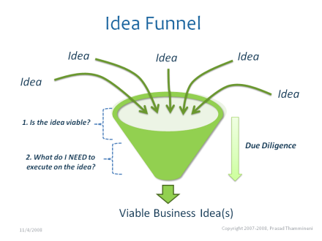
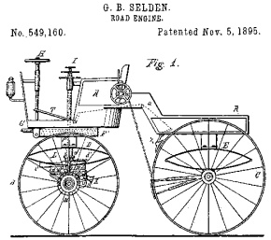
Creating Impact: Commercializing University Technology
Idea Disclosure Screening Protection License Commercialization

Slide 10
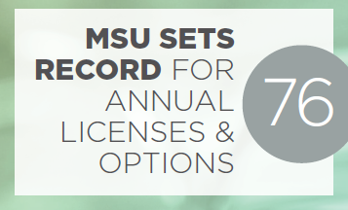
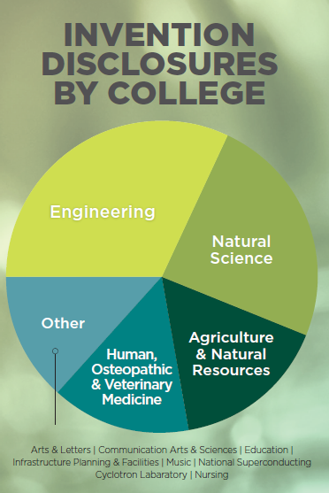
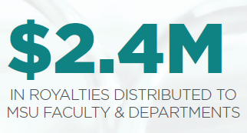
Steps to Licensing
Identify Protect Enhance Capture
Technology Screening
Detailed Assessment & Marketing
Licensing
IP Protection
Translational Research
Funding opportunities
Commercialization is achieved by licensing the IP rights to companies who commit to commercialize the technology.

Slide 11
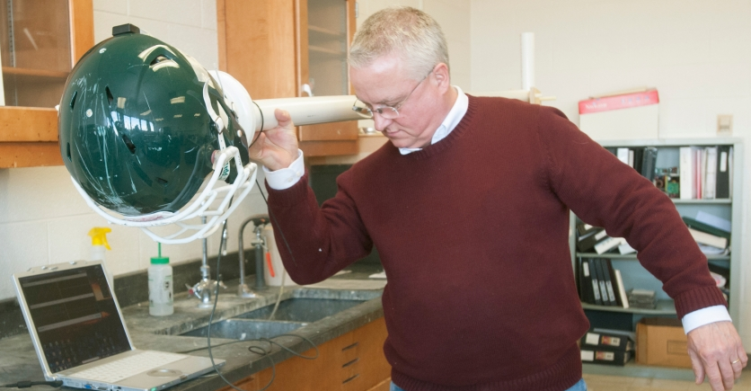
Translational Research
Translational Research
Improve the Technology (gap funding)
Proof of concept
prototype development
test in a specific application
test for critical failure modes
Sources
MSU Targeted Support Grant for Tech Development ($50K-$100K)
MSU ADVANCE Proof of Concept Program ($40K matching)
MTRAC: Michigan Translational Research and Commercialization ($25K - $100K)
MSU researchers tackle concussions with new technology

Slide 12
Funding and Commercialization
Startup
SPG
SBIR/
STTR
Ideation/Innovation
Venture/Angel Funds
Research
ADVANCE, TSGTD& MTRAC
MSUF
Seed
Pre-Seed
MSUF
Translational Research
MEDC
MEDC
Exploration
Invention
MEDC
Existing Company
Early-stage Mid-stage Late-stage
Gap Funding
TSGTD
+ MEDC
MCRN
Biz Plan
Competitions
MEDC
Corporate Follow-on Investment
Science
Discovery
Evaluation
Development
License/Launched
Funding Chart

Slide 13
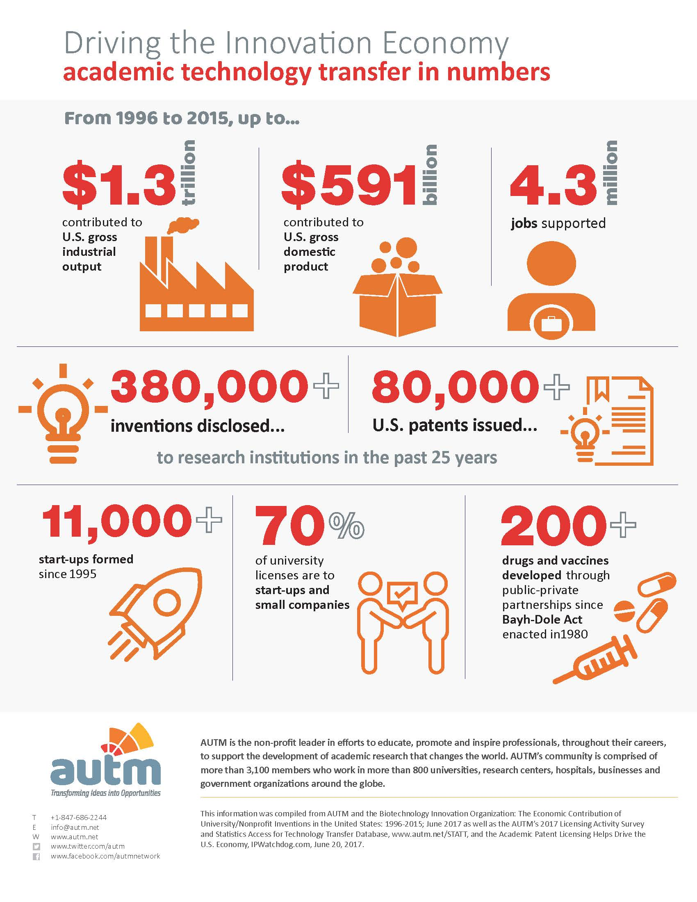
Driving the innovation Economy

Slide 14
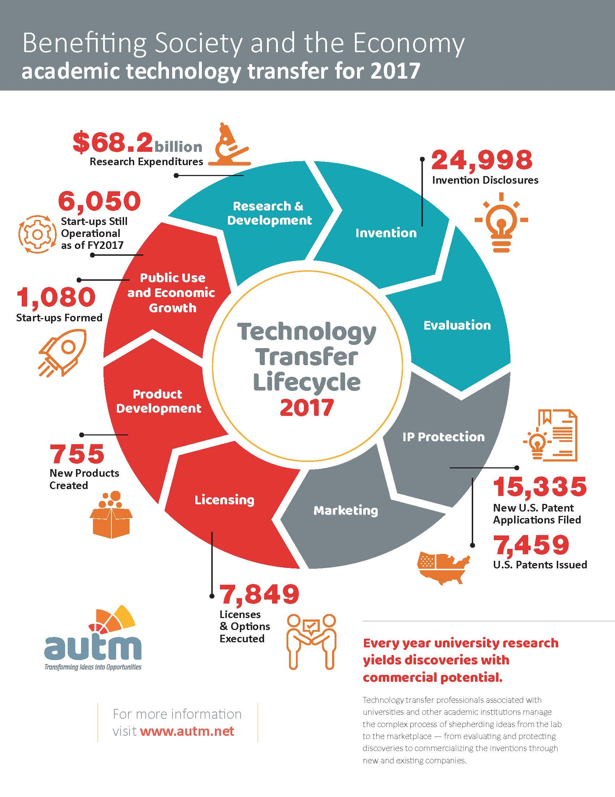
Benefiting Society and the Economy

Slide 15
Pipeline of Opportunities
Pipeline of Opportunities
Discovery
Business Formation
Validation
Structured process for startup incubation
Access to dedicated pre-seed venture fund
Over 20 faculty and student startups in past three years
Led by experienced entrepreneurs

Slide 16
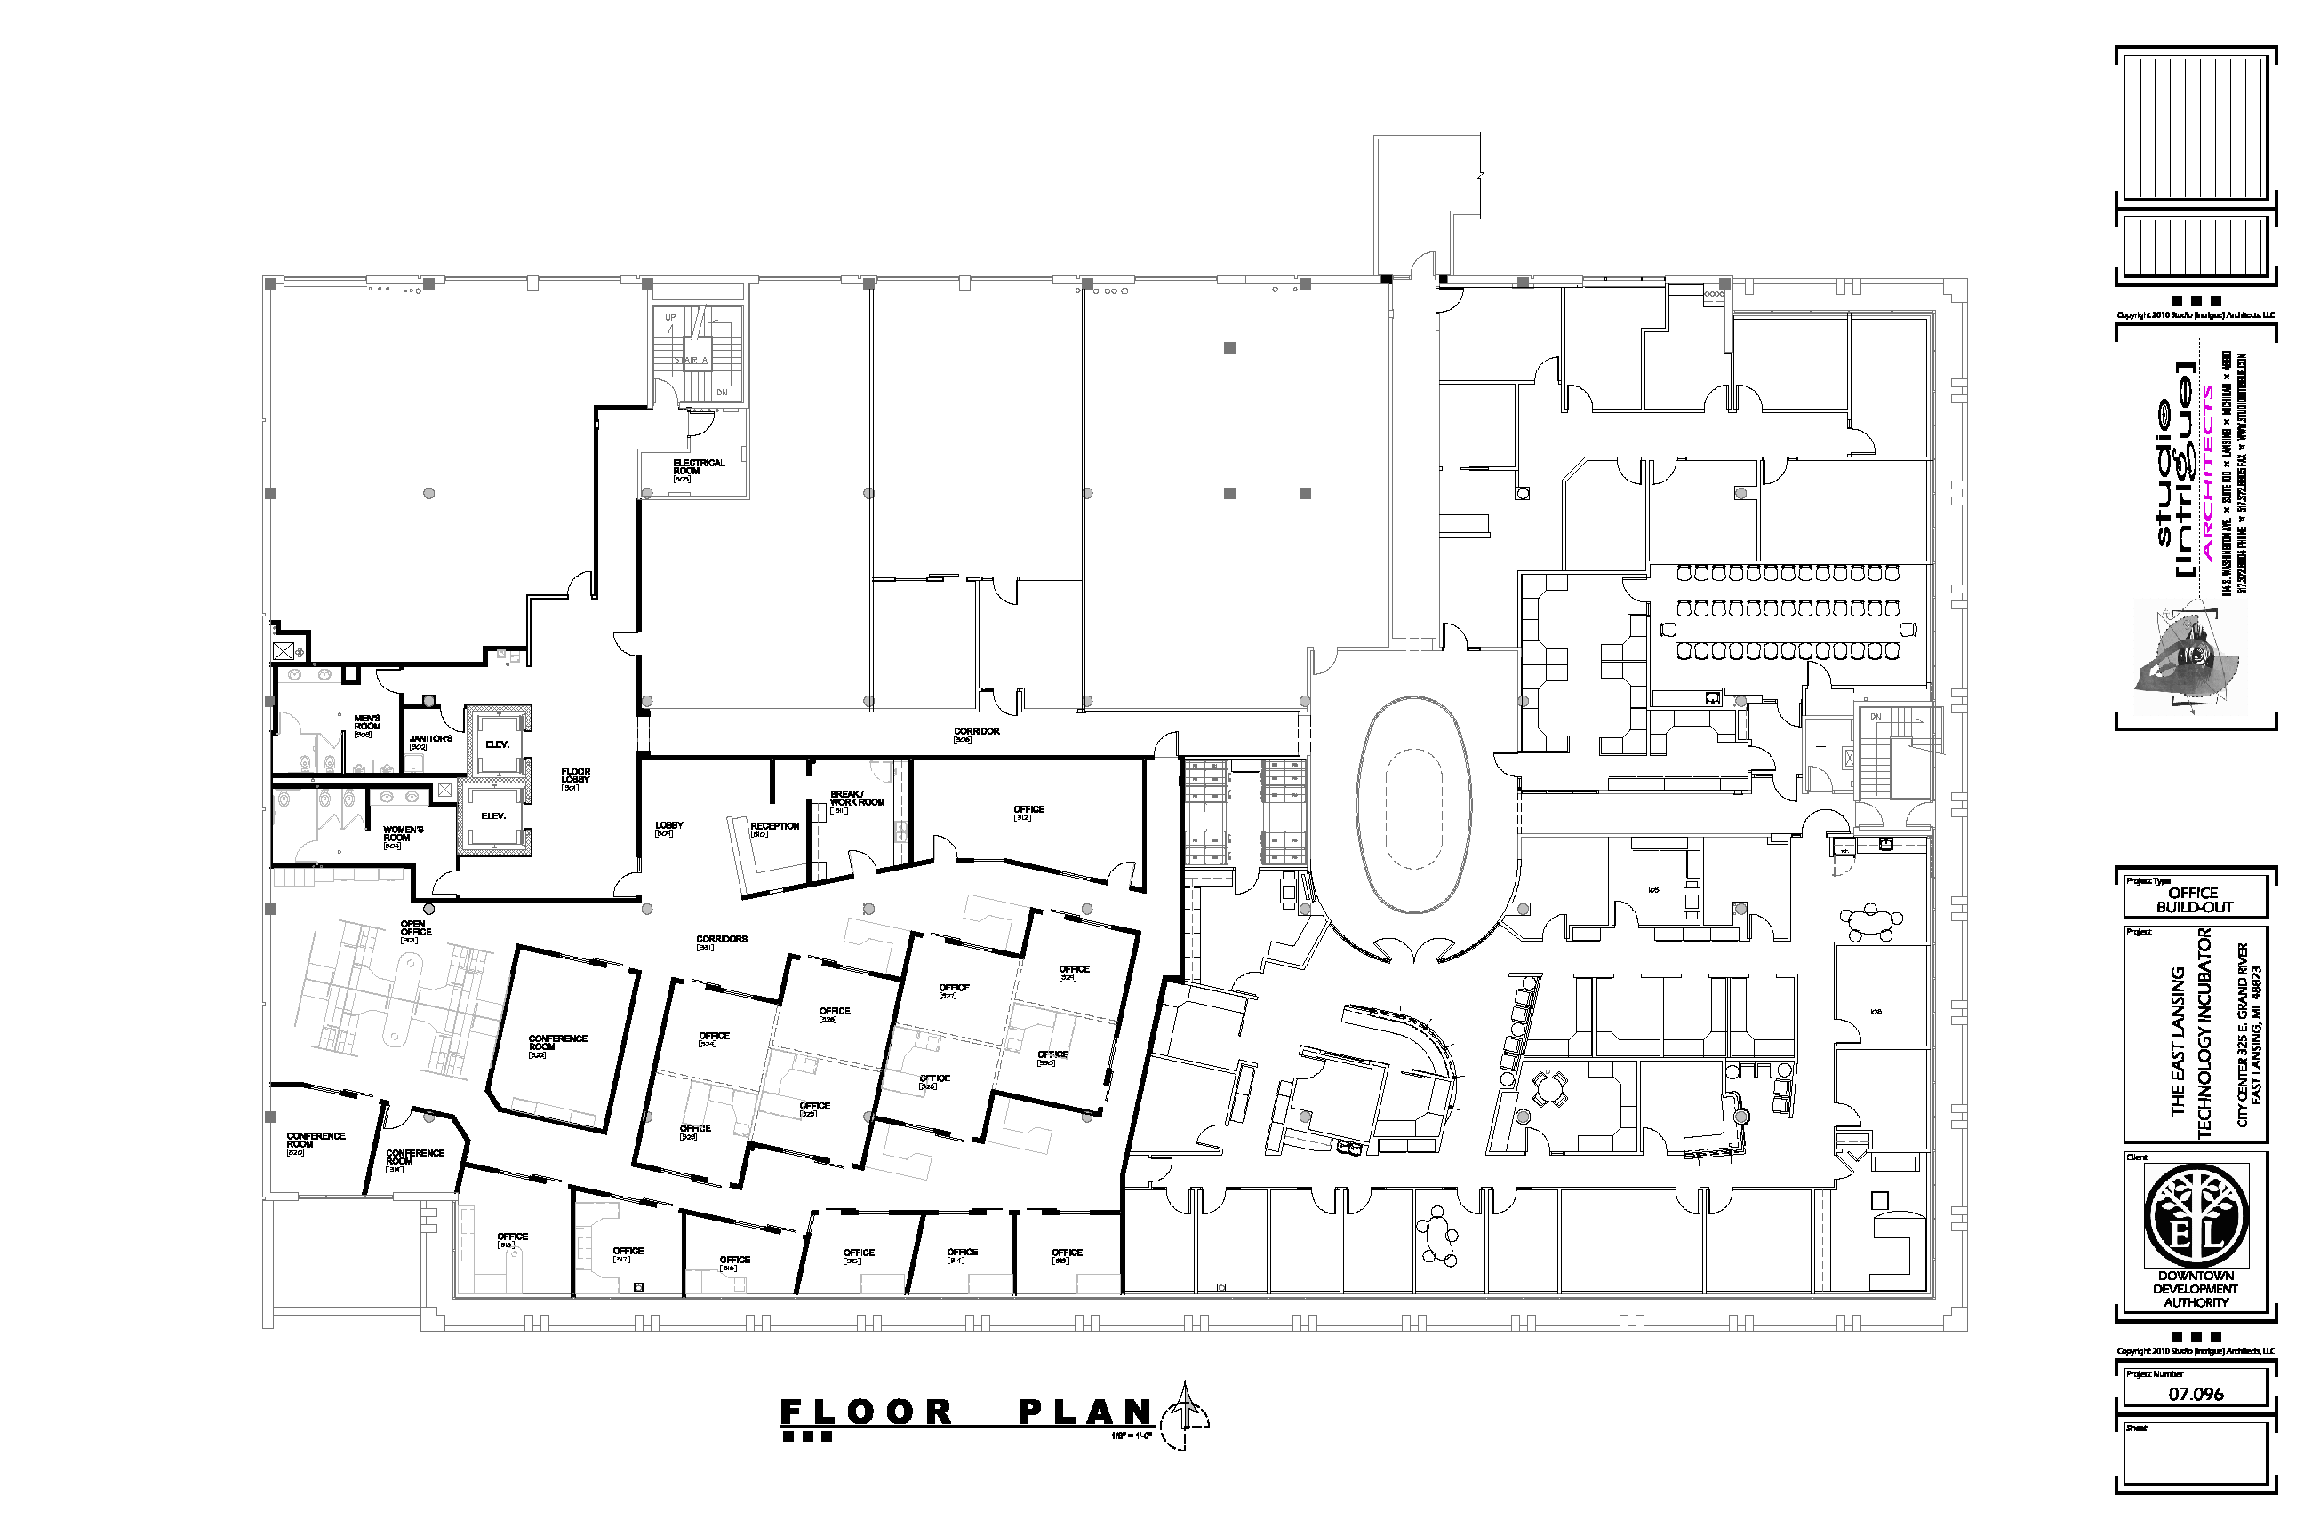
MSU’s place for connecting to the private sector - come visit any time
Visit us at our
web portal…
http://innovationcenter.msu.edu
325 E. Grand River Ave.
East Lansing, Michigan 48823 517-884-2370
300
Room

Slide 17
Q & A

